Slide 1
Validity of Research Designs
Elizabeth Tipton
NSF Improving Education R&D Evaluations Workshop
2021

Slide 2
The principal function of research design is to support validity claims about the findings of research studies.

Slide 3
Four validity types
Shadish, Cook, and Campbell (2002) define:
Internal validity
External validity
Statistical conclusion validity
Construct validity

Slide 4
Potential outcomes

Slide 5
What is our goal?
In an evaluation, our goal is to understand if an intervention causes a different outcome than what would have occurred without otherwise.
Embedded in this:
Intervention = a treatment, program, training, etc.
Outcome = any measure
Comparison = what would have occurred otherwise, often ‘business-as-usual’
Causal effects are inherently *comparative*.

Slide 6
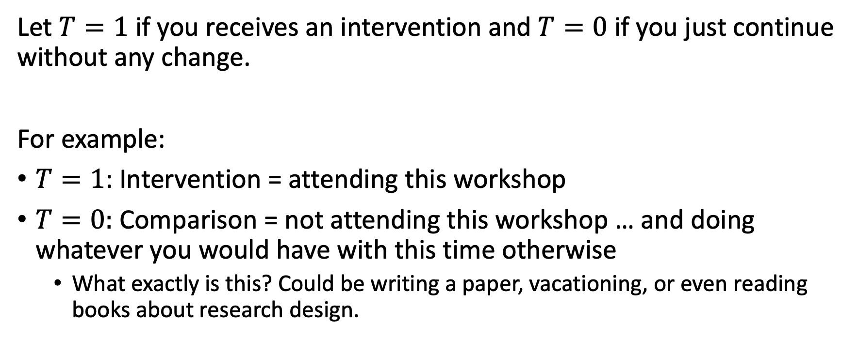
More formally
Let $T=1$ if you receives an intervention and $T=0$ if you just continue without any change.
For example:
$T=1$: Intervention = attending this workshop
$T=0:$ Comparison = not attending this workshop … and doing whatever you would have with this time otherwise
What exactly is this? Could be writing a paper, vacationing, or even reading books about research design.

Slide 7
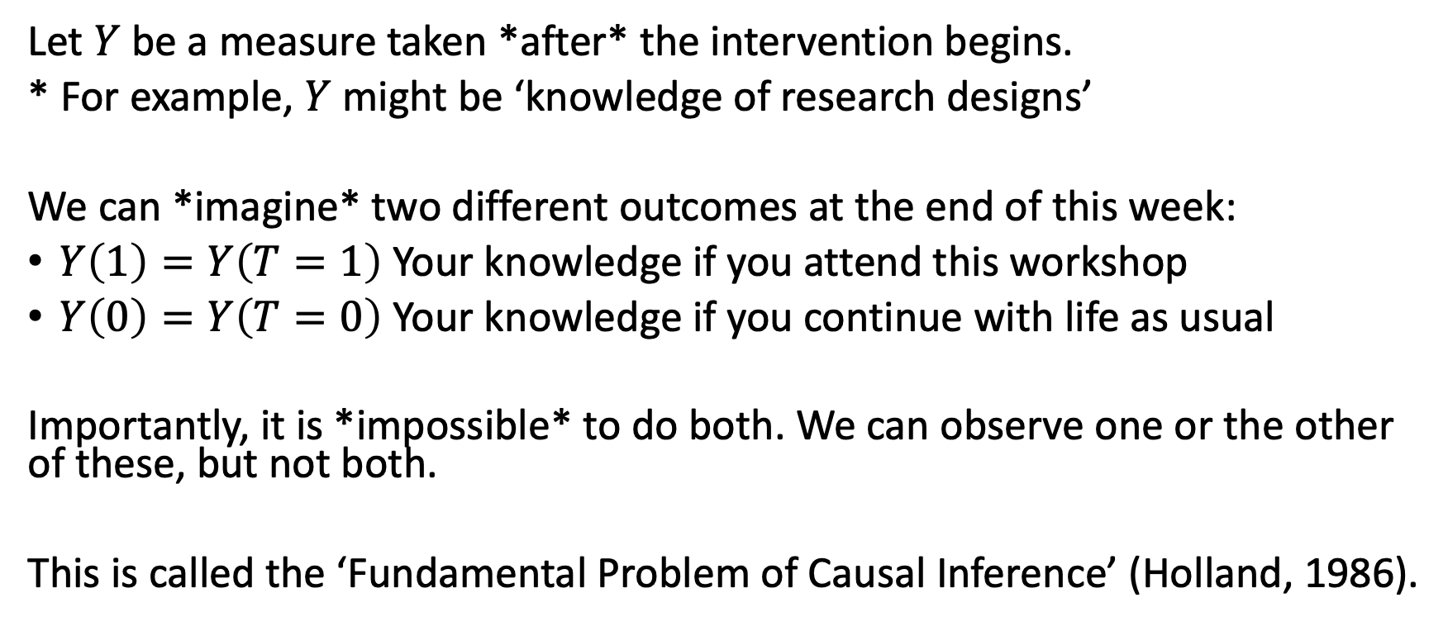
Potential outcomes
Let $Y$ be a measure taken *after* the intervention begins.
* For example, $Y$ might be ‘knowledge of research designs’
We can *imagine* two different outcomes at the end of this week:
$Y\left(1\right)=Y\left(T=1\right)$ Your knowledge if you attend this workshop
$Y\left(0\right)=Y\left(T=0\right)$ Your knowledge if you continue with life as usual
Importantly, it is *impossible* to do both. We can observe one or the other of these, but not both.
This is called the ‘Fundamental Problem of Causal Inference’ (Holland, 1986).

Slide 8
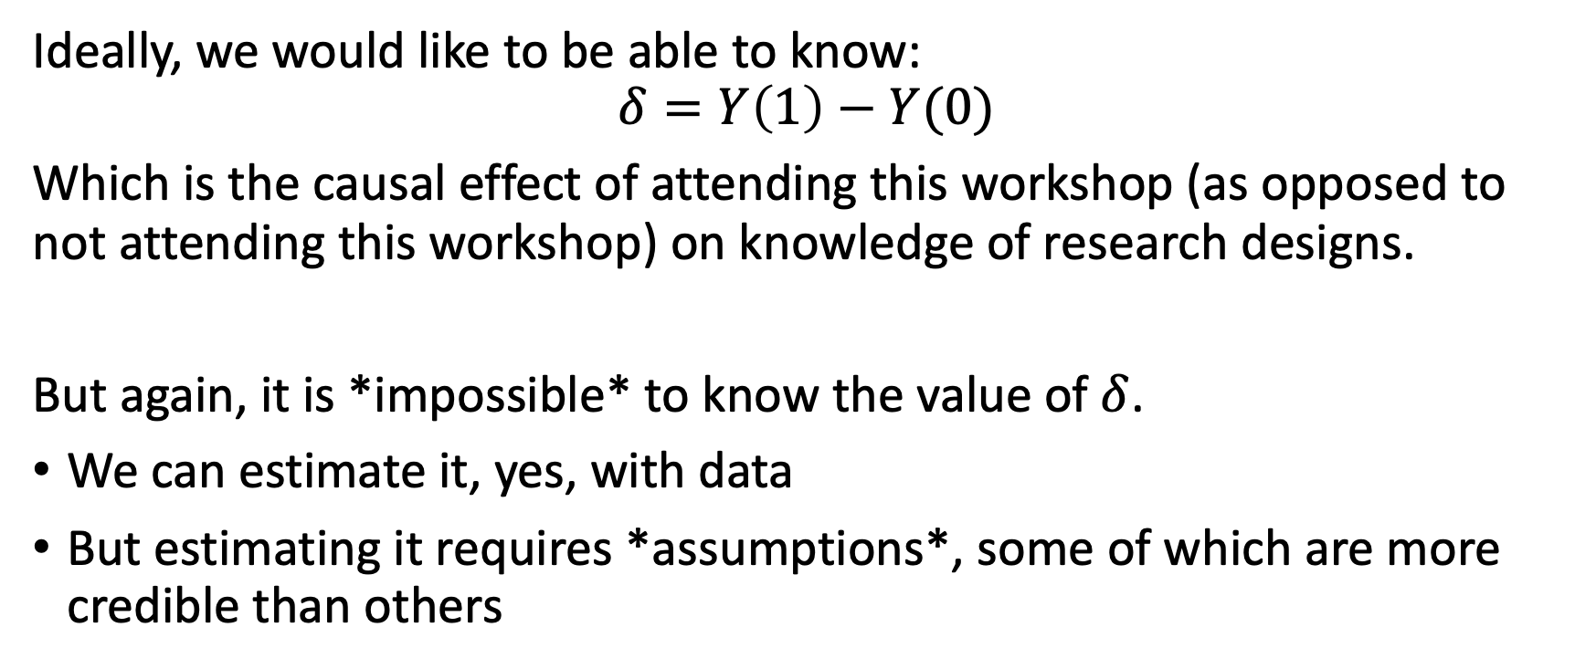
Individual treatment effects
Ideally, we would like to be able to know:
$$δ=Y\left(1\right)−Y(0)$$
Which is the causal effect of attending this workshop (as opposed to not attending this workshop) on knowledge of research designs.
But again, it is *impossible* to know the value of $δ$.
We can estimate it, yes, with data
But estimating it requires *assumptions*, some of which are more credible than others

Slide 9
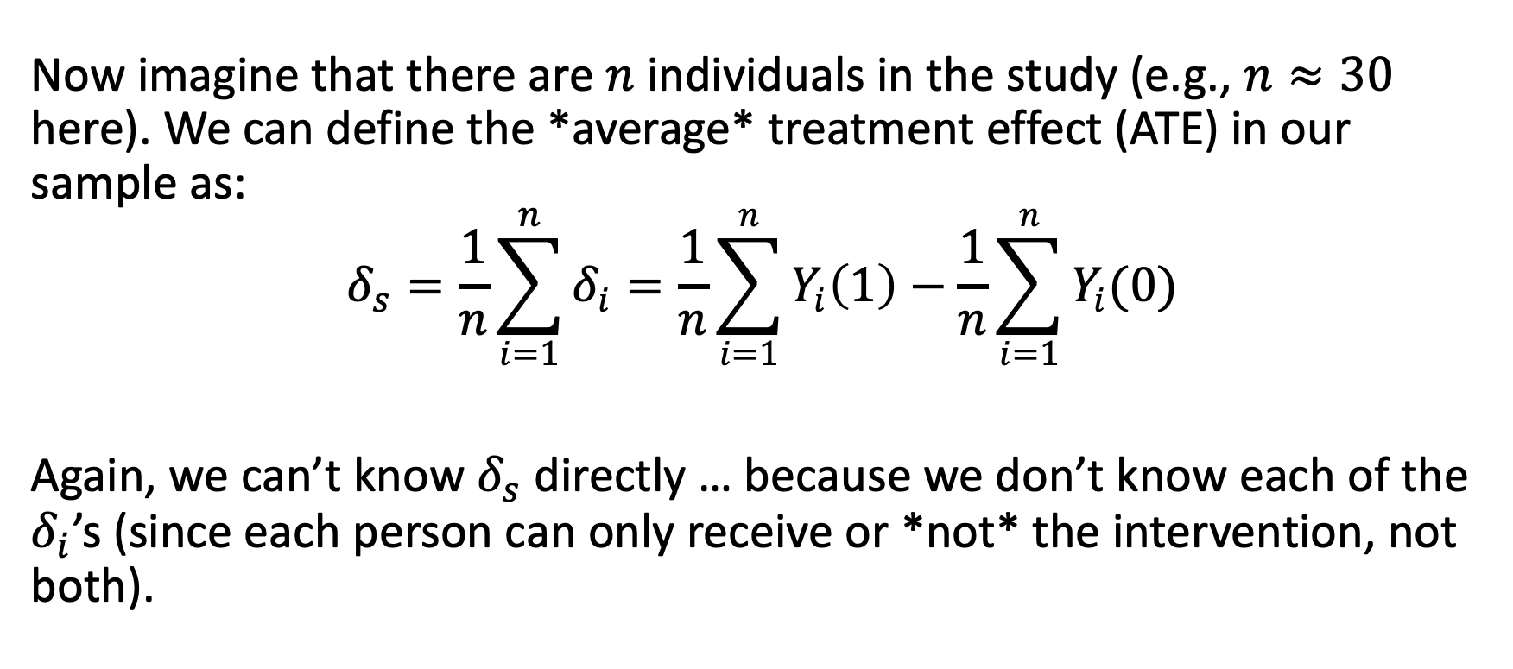
Average treatment effects
Now imagine that there are $n$ individuals in the study (e.g., $n≈30$ here). We can define the *average* treatment effect (ATE) in our sample as:
$$δ_{s}=\frac{1}{n}\sum_{i=1}^{n}{δ_{i}}=\frac{1}{n}\sum_{i=1}^{n}{Y_{i}\left(1\right)−\frac{1}{n}\sum_{i=1}^{n}{Y_{i}(0)}}$$
Again, we can’t know $δ_{s}$ directly … because we don’t know each of the $δ_{i}$’s (since each person can only receive or *not* the intervention, not both).

Slide 10
What do you mean impossible?
Wait, you might think, can’t I figure this out?
For example, I could compare:
Participant’s knowledge of research design before the workshop to their knowledge after.
Participant’s knowledge of research design at the end, compared to general knowledge of research design in the field
These approaches are *imputing* the missing potential outcome using *assumptions* and extant data.

Slide 11
What would you have been doing otherwise?
To see what we mean, ask yourself: If you didn’t attend this workshop, would you have done *nothing* at all to learn about research design this year?
Nothing?
Or might you have:
Read a book
Attended another workshop
Consulted with an expert

Slide 12
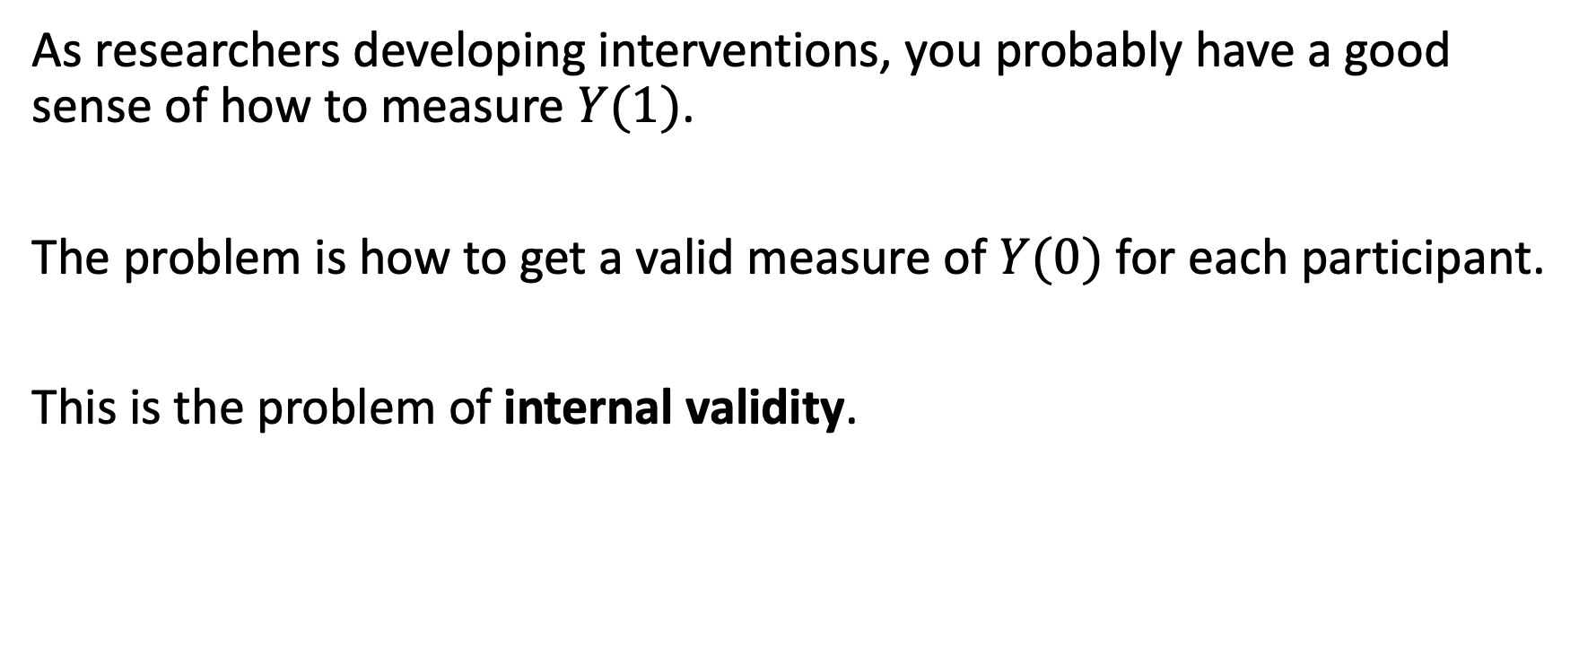

It’s all about $Y(0)$
As researchers developing interventions, you probably have a good sense of how to measure $Y(1)$.
The problem is how to get a valid measure of $Y(0)$ for each participant.
This is the problem of internal validity.

Slide 13
Internal Validity

Slide 14
Internal validity refers to the extent to which a research design establishes a trustworthy cause-and-effect relationship between an intervention and an outcome.

Slide 15
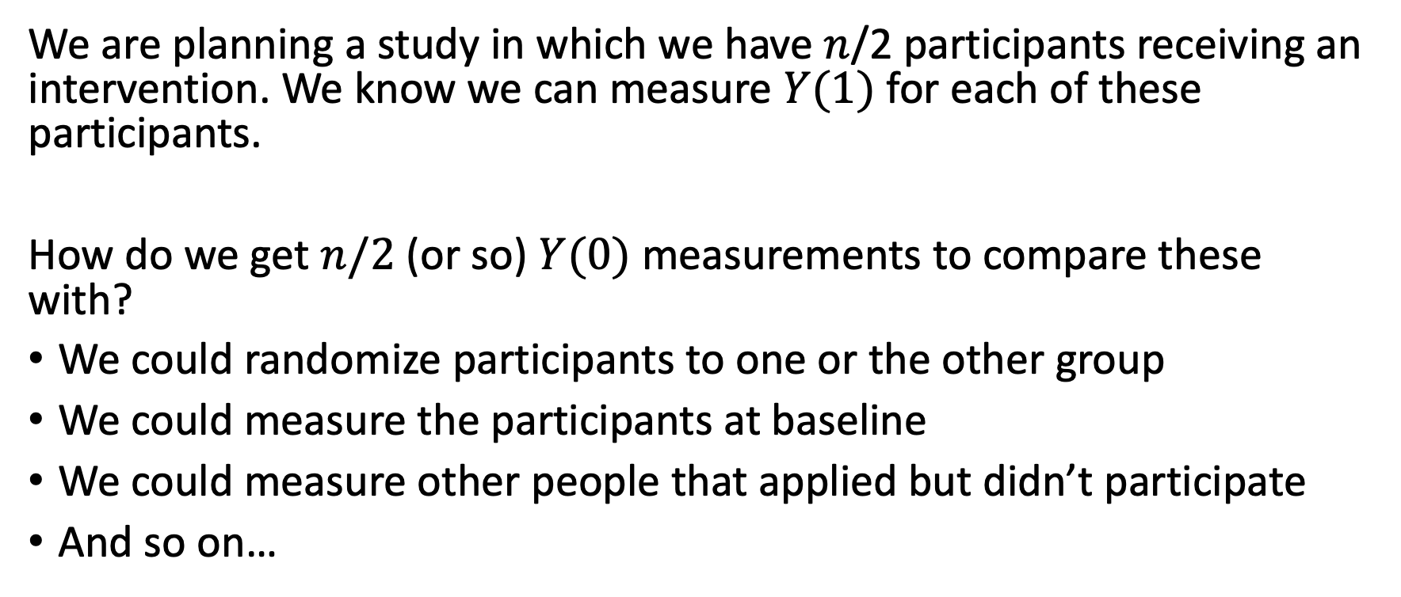

We have $Y(1)$ and choose $Y\left(0\right)$
We are planning a study in which we have $n$/2 participants receiving an intervention. We know we can measure $Y(1)$ for each of these participants.
How do we get $n/2$ (or so) $Y(0)$ measurements to compare these with?
We could randomize participants to one or the other group
We could measure the participants at baseline
We could measure other people that applied but didn’t participate
And so on…

Slide 16
7 common threats
In order to determine causality, we need to rule out 7 threats:
Ambiguous temporal precedence
Maturation
Selection
Attrition
Testing effects
Instrumentation
Regression

Slide 17
Ambiguous temporal precedence
Cause must precede effect.
(It’s not obvious that this is true in *cross-sectional* designs.)

Slide 18
Maturation
Over time, individuals grow older,
wiser and more experienced for
reasons that have nothing to do with interventions.
(It’s possible you would have eventually learned research design without us.)

Slide 19
Selection
Groups taking part (or not) in
interventions often differ in a
variety of ways other than the
use of the intervention.
(Not everyone wants to spend a week learning research design.)

Slide 20
Attrition
Often, not every participant that begins
in a study persists throughout the
study. Quitting may be related to
both the intervention and the outcome.
(Maybe we’re really boring? Maybe you already know this material?)

Slide 21
Testing effects
The act of observing (or measuring)
may change the phenomenon being
observed in substantial ways.
(Now that I’ve told you that your knowledge will be measured, might you pay attention more?)

Slide 22
Instrumentation
The same instrument or observation
protocol might not measure the
same construct at different points in time.
(Might you think you know more about research design before you learn about research design? *Dunning-Kruger* effect?)

Slide 23
Regression
If participants are selected into the study
because they are above or below their
group mean on this pretest, then we would
expect their posttest scores to be closer to the mean.
(Why? Because the pre-test knowledge is not perfectly measured – there is error in it. This leads to ‘regression to the mean.’)

Slide 24
Research designs rule these out
A research design that has *strong internal validity* rules these threats out by *design*.
Weaker designs rule these out by *assumption*.
The weakest designs don’t even rule them out.

Slide 25
External Validity (Generalizability)

Slide 26
External validity refers to the issue of whether the relation observed between ‘cause’ and ‘effect’ can be generalized from the settings, persons and contexts studied to those in a broader population intended by the researcher.

Slide 27
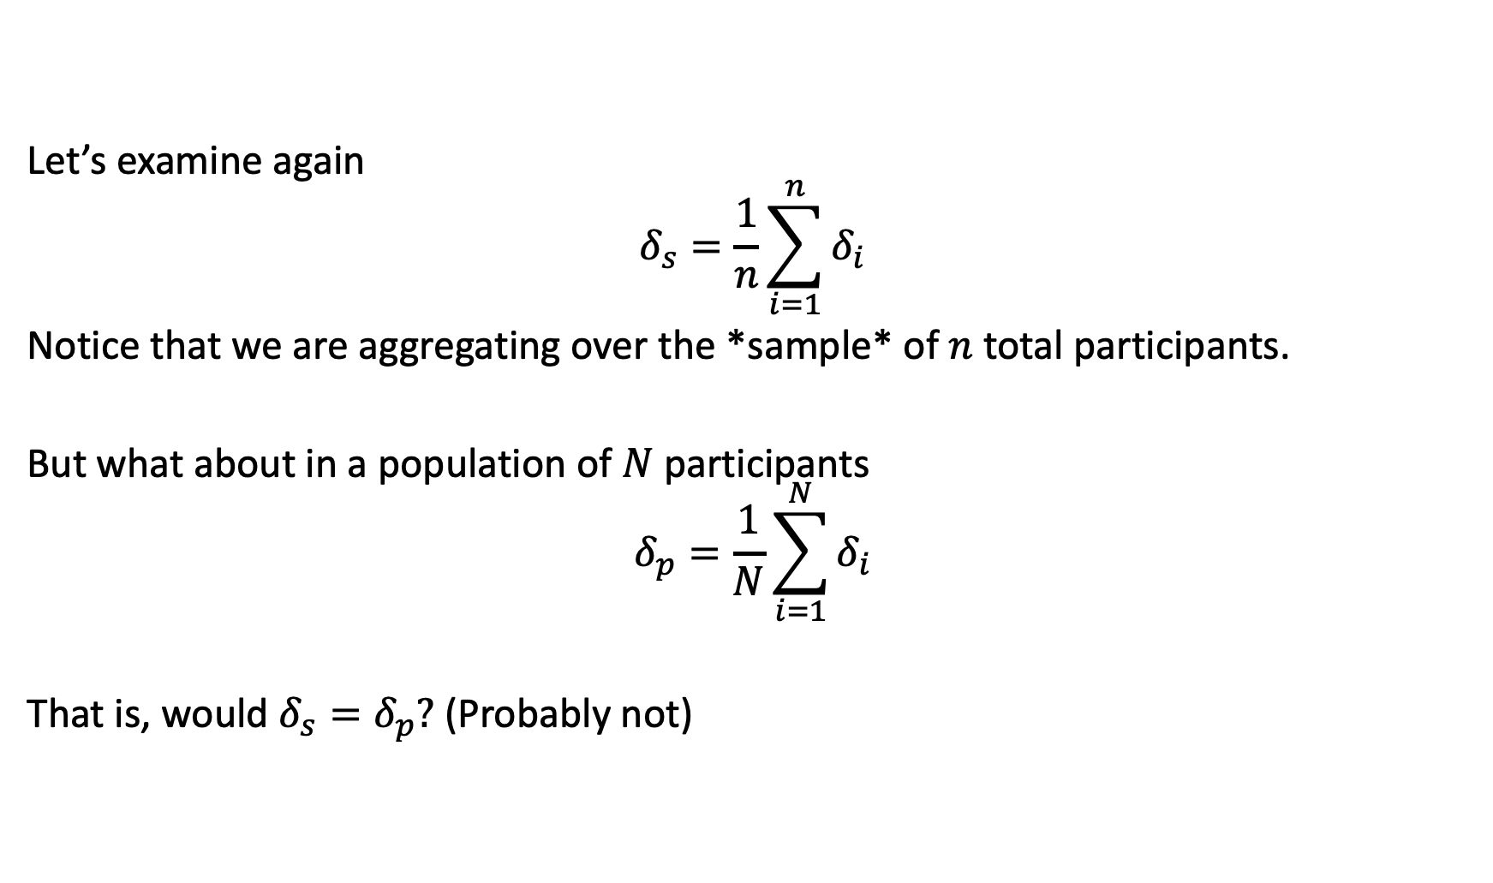
Return to potential outcomes
Let’s examine again
$$δ_{s}=\frac{1}{n}\sum_{i=1}^{n}{δ_{i}}$$
Notice that we are aggregating over the *sample* of $n$ total participants.
But what about in a population of $N$ participants
$$δ_{p}=\frac{1}{N}\sum_{i=1}^{N}{δ_{i}}$$
That is, would $δ_{s}=δ_{p}?$ (Probably not)

Slide 28

How can we leap from $δ_{s}$ to $δ_{p}$?
A research design that has *strong external validity* connects the sample to the population via a strong *design*.
Weaker designs make this link using models and *assumptions*.
The weakest designs don’t even acknowledge that they differ.

Slide 29
Generalizability isn’t generalizable
The generalizability of a study’s results is an ambiguous concept without specifying the target of generalization—the supposed population or scope of applicability to which the study’s results are supposed to apply.
For example, the target population could be:
Education researchers interested in colleges of education
NSF funded education researchers
And so on….

Slide 30
Initial field studies
It is *very hard* to conduct an evaluation that has good internal validity.
It is even *harder* to conduct a study with both strong internal and external validity.
For this reason, we think that initial field studies should worry less about external validity than internal validity.

Slide 31
Initial field studies
Our position is that initial field studies should worry the most about having strong internal validity and save questions of external validity for efficacy and effectiveness evaluations.
In practice, this means treating the sample of participants / schools as ’fixed’ (instead of as a ‘random’ sample).
This choice and its implications should be made very clear in all research reports.

Slide 32
Statistical Conclusion Validity

Slide 33
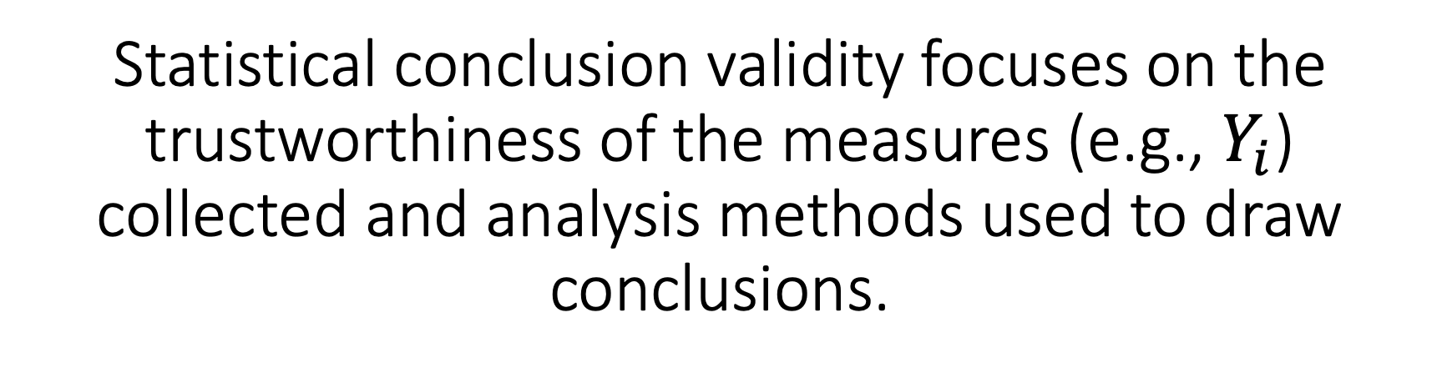
Statistical conclusion validity focuses on the trustworthiness of the measures (e.g., $Y_{i}$) collected and analysis methods used to draw conclusions.

Slide 34
3 threats to worry about
Unreliable measures
Incorrect data elements
Incorrect analyses

Slide 35
Unreliable measures
A measure is reliability if it would give the
same result if collected again.
(Check those Cronbach alphas …)

Slide 36
Incorrect data elements
In quantitative studies, this can happen
when data is coded incorrectly
(e.g., there are errors in tabulation,
matching, or aggregation).
(This is where using careful, reproducible code can help, as can double checking any ‘surprising’ findings.)

Slide 37
Incorrect analyses
There must be alignment between the
research design chosen and the statistical
analysis conducted.
(For example, an ANOVA only results in the correct treatment effect estimate if the groups were randomized.)

Slide 38
Construct Validity

Slide 39
The final validity threat concerns whether the explanation given by the study has correctly identified the constructs in the interpretation.

Slide 40
Examples of problems
Hawthorne effects
Novelty effects

Slide 41
Keep in mind
Construct validity of explanation is not a property of designs, but of interpretation of evidence from designs, which inevitably involve the theoretical framework in which the research is embedded.
While construct validity of explanation is crucial in the broader interpretation of evaluation research, it is difficult for a single evaluation study, particularly a small-scale study conducted in the development process, to address it.

Slide 42
Conclusion

Slide 43
Developing a strong research design involves careful consideration of a variety of potential threats.

